Slide 1
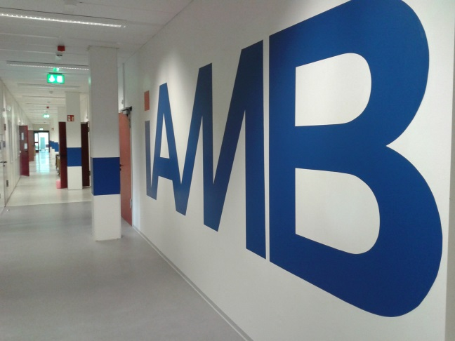
Quantitative Microbiology I
Stoichiometric models
Lars M. Blank

Slide 2
Content
Industrial Example
Bioethanol production with Yeast
Stoichiometric
models
Definition
Setup
Tutorial

Slide 3
Metabolic Flux Models
Objective
Introduce stoichiometric models and demonstrate how they are used to estimate internal rates: metabolic flux analysis (MFA)
Content
Industrial example
Constructing and using stoichiometric models

Slide 4
Why is the intracellular flux distribution of interest?
Notes:
This question will be partly answered in the next 2 weeks starting with regulation in prokaryotes followed by special examples from eukaryotes.

Slide 5
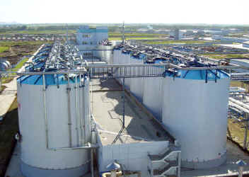
Ethanol Production by Yeast
Fuel Ethanol Plant for Jilin Fuel Ethanol Co. Ltd,
Jilin, PR China: 2.5 million litre/day

Slide 6
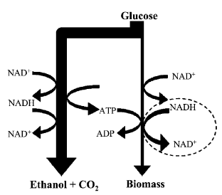
Lyngby, Denmark - May 11, 2006. Fluxome Sciences announces today that its patent application on improving bioethanol production in yeast has been granted in Europe and in the United States (EP1097216 and US7018829). The method aims at engineering the ammonia assimiliation in yeast. By modification of the redox metabolism, it is possible to reduce the production of the by-product glycerol (and/or xylitol) and thereby increase ethanol production by 5 percent. Proof-of-concept has been shown under laboratory conditions and Fluxome Sciences currently introduces its technology into industrial yeast. In 2005, production of bioethanol exceeded 40 billion liters and the market is expected to grow rapidly in the coming years due to high oil prices and subsequently the demand to become independent from fossil energy resources. An increase in bioethanol production of even less than 5%, can significantly reduce the cost of bioethanol production. The technology has the potential to contribute to an increase in production of bioethanol from both traditional renewable resources including corn, sugar cane and wheat, and lignocellulosic based resources. About Fluxome Sciences http://www.fluxome.com/ Fluxome Sciences operates within the field of White Biotechnology, i.e. the bio-based production of chemical compounds. Fluxome Sciences is a product company located in Copenhagen which focuses on the bio-based production of nutraceuticals and biofuels. Using its Metabolic Engineering platform and through the insertion of genetic modifications in living organisms (yeasts of any type but also bacteria and fungi), Fluxome Sciences builds improved cell factories, enhances production yields and optimizes bioprocesses.
Fluxome Sciences' patent application on improving bioethanol production has been granted in Europe and the US
C. Bro et al. Metabolic Engineering 8 (2006) 102–111

Slide 7
Glutamate synthesis
2-Oxoglutarate+NH₄+NAD(P)H ⬅➔ L-Glutamate+NAD(P)⁺
GDH1:
NADPH dependent
catalysis primarily the forward reaction
GDH2
NADH dependent
catalysis primarily the reverse reaction
Deletion of GDH1 and overexpression of GDH2
2-Oxoglutarate+NH₄+NADH ➔ L-Glutamate+NAD⁺

Slide 8
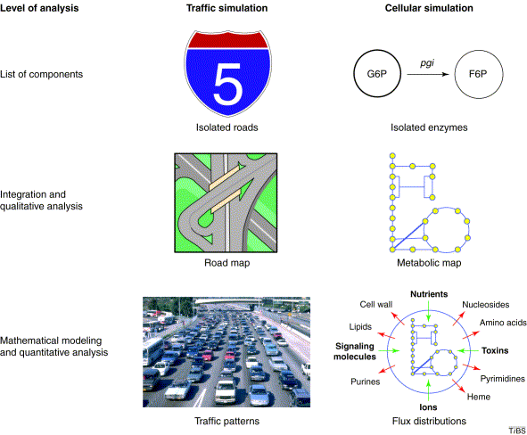
Covert et al., TIBS, 2001

Slide 9
The cell as a black box model
substrate S_{i}
r_{Si}
?
r_{Pi}
System boundary
product P_{i}
μ
biomass X
Overall balance equation:

Slide 10
Average Biomass Composition

Slide 11
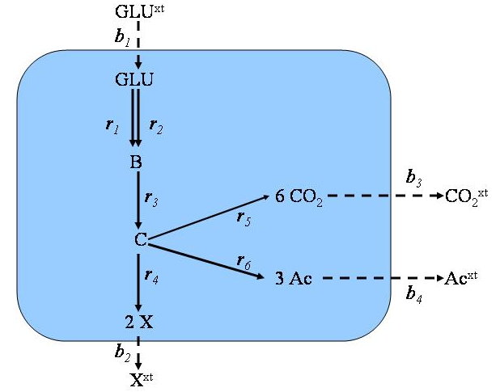
Metabolic Networks: Definition
System definition: internal vs. external metabolites
Reaction stoichiometry: ratios of substrates / products
Reaction directionality: reversible / irreversible
Metabolic fluxes: rates of metabolic reactions

Slide 12
Metabolic Networks: Definition
Number of (internal) metabolites: n = 6
Number of metabolic reactions: q = 10
Sets of reversible and irreversible reactions

Slide 13
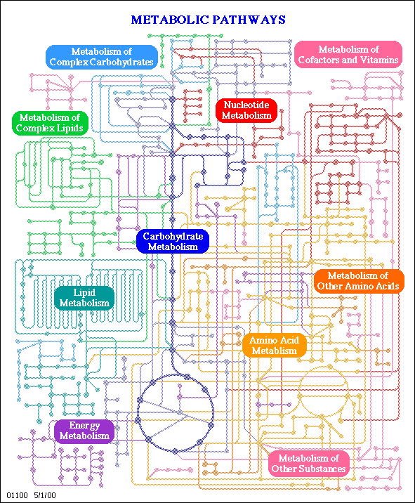
Constructing a stoichiometric model
GLU^{xt}
C
C
C
C
C
C
b₁
E₃
E₁
E₄
GLU
GLU
GLU
B
C
C
B
C
C
C
C
C
C
2 X
E₂
E₅
r₁
r₂
GLU
C
B
6 CO₂
B
E₆
C
C
C
C
C
C
B
C
3 Ac
C
b₃
C
System boundary
r₃
CO₂
6 CO₂
CO₂^{xt}
r₅
C
C
C
C
C
C
C
r₆
C
C
C
C
r₄
Ac
3 Ac
Ac^{xt}
b₄
C
C
C
2 X
X
intracellular
b₂ (µ)
extracellular
C
C
C
X^{xt}

Slide 14
Steady state
r₁
r₂
r₁
r₂
B
B
r₃
r₃

Slide 15
Steady state
R₁
r₂
r₁
r₂
B
B
r₃
r₃

Slide 16
Steady state
r₁
r₂
r₁
r₂
B
B
r₃
R₃

Slide 17
Steady state
r₁
r₂
r₁
r₂
For time scales here (>sec) we assume steady state (no changes).
B
B
r₃
r₃

Slide 18
Stoichiometry at steady state
GLU:
b₁-r₁-r₂ = 0
B:
r₁+r₂-r₃ = 0
C:
r₃-r₄-r₅-r₆ = 0
CO₂:
6·r₅-b₃ = 0
Ac:
3·r₆-b₃ = 0
X:
2·r₄-b₂ = 0
Internal fluxes
Exchange fluxes
S = (# of metabolites × # of reactions)

Slide 19
Stoichiometry at steady state
If we assume steady state, i.e. nothing changes over time, then
S·v = 0

Slide 20
Linear algebra of stoichiometric networks
Fluxes v are inherent variables in stoichiometric models.
Can they be calculated? Linear algebra provides the tools!
Let‘s try Gaussian elimination!

Slide 21
Linear algebra of stoichiometric networks
Fluxes v are inherent variables in stoichiometric modelling.
Can they be calculated? Linear algebra provides the tools!
r₁ ,r₂, b₁ ,b₂, b₃, b₄ cannot be solved independently
⇒ set r₂, b₂ , b₃, b₄

Slide 22
Linear algebra of stoichiometric networks
A structured approach for analysis of stoichiometric matrices:
S (n×m), i.e. S comprises n balance equations (metabolites) and m unknown variables (fluxes).
1. Determine the number p of linearly independent equations:
p = rank(S)
2. Calculate the degree of freedom (DF):
DF(S)= m - p
There are three possibilities:
DF(S) = 0 ⇒ well-determined: one possible solution
DF(S) > 0 ⇒ underdetermined: more than one solution, optimization problem (linear programming);
DF(S) < 0 ⇒ overdetermined (e.g. experimental data): minimize overall error (least square etc.)

Slide 23
Linear algebra of stoichiometric networks
A structured approach for analysis of stoichiometric matrices:
= (6×10)
1. Determine the number p of linearly independent equations:
p = rank(S) = 6
2. Calculate the degree of freedom (DF):
DF(S)= m – p=10 - 6= 4
⇒ See results of our Gaussian elimination, we either have to provide values for 4 fluxes (r₂, b₂, b₃, b₄) or optimize

Slide 24
A possible flux solution
Set r₂ = 0, b₃ = 0, b₄ = 0 and b₁ = 100:
⇒ we can obtain a unique solution with
r₁
r₂
r₃
r₄
r₅
r₆
b₁
b₂
b₃
b₄
100
0
100
100
0
100
0
0
0
0
200

Slide 25
Stoichiometric models can easily be extended
GLU^{xt}
O2^{xt}
b₁
b₅
GLU
O2
2ATP
ATP
r₇
r₁
2 ATP
r₁
r₂
r₂
NADH
B
ATP
b₃
2 ATP, 1 NADH
r₃
6 CO₂
CO₂^{xt}
r₅
C
r₆
10 ATP
r₄
3 Ac
Ac^{xt}
2 NADH
b₄
2 X
b₂
X^{xt}
Additional biochemical information

Slide 26
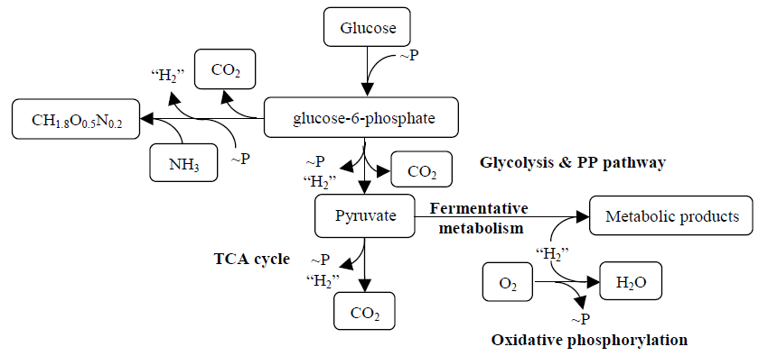
Model of biosynthesis

Slide 27
Biomass Equation
Assumptions:
Biomass is synthesized from glucose
No additional carbon source is present (minimal medium)
CH_{1.8}O_{0.5}N_{0.2}
27

Slide 28
Biomass Equation
C
DoR
NADH
ATP

Slide 29
Maintenance Energy
Maintenance of concentration gradients
Maintenance of electrical potential
Turnover of biopolymers
Futile cycles

Slide 30
Stoichiometry of cellular reactions
Biomass, substrates, products and metabolites
S
X_{met}
P

Slide 31
Reaction network
X
3~P
2~P,“H₂”
~P
v₂
v₁
substrate
M₁
M₂
M₃
Product 1
v₃
v₄
v₅
~P
2“H₂”
v₆
Product 2

Slide 32
Stoichiometry
γX
AS
BP
GX_{met}
E.g., R4: 0X + 0p₁ + 0p₂ + 0s +0M₁- 1M₂ + 1M₃ +2~P +H₂ = 0

Slide 33
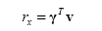
Formulation of reaction rates
Stoichiometry
Rates:
use stoichiometric matrix
use rate vector
in stoichiometric matrix
Row: reactions
Column: Metabolites
Rates

Slide 34
Rates
Rates are defined for each reaction (v₁, v₂, …, v₆)
and have unit mmol/C-mol biomass/h.

Slide 35
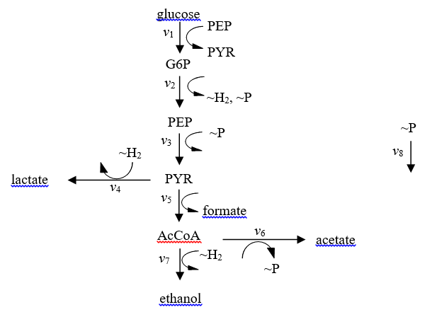
Tutorial I: Lactic acid bacteria

Slide 36
Homework: Lactic acid bacteria

Slide 37
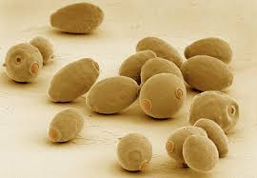
Next week -> some yeast again

Slide 38
Pseudo steady state
r_{met} = 1.1 mmol/g_{CDW}/h
M₂
v₃
v₄
μC_{met} = 0.1 μmol/g_{CDW}/h
„Dilution“ term due to biomass increase
Typical concentration: 1 µmol/g_{CDW}
Notes:
Typical concentration: 1 µmol/gCDW

Slide 39
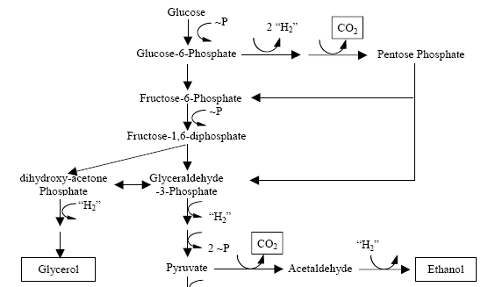
Tutorial II: Bioethanol production: Yeast anaerobe metabolism

Slide 40
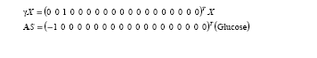
Stoichiometry of yeast

Slide 41
Simplified Yeast anaerobe metabolism

Slide 42
Tutorial: Yeast anaerobe metabolism
Task:
Translate reaction network into a stoichiometric model.
Formulate the balances of the 8 reactions
Present the reactions in the form:

Slide 43
Stoichiometry of reaction network

Slide 44
Rate Equation of reaction network

Slide 45
Example
Data from Schulze (1995)
Dilution rate, h⁻¹ | Y_{xe} | Y_{xs}
0.1 | 2.15 | 1.31
0.2 | 2.23 | 1.34
mmol/C-mol biomass

Slide 46
Gene deletions
GLU^{xt}
O2^{xt}
b₁
b₅
GLU
O2
2ATP
ATP
r₇
r₁
2 ATP
r₁
r₂
r₂
NADH
B
0 =
ATP
b₃
2 ATP, 1 NADH
r₃
6 CO₂
CO₂^{xt}
r₅
C
r₆
10 ATP
r₄
3 Ac
Ac^{xt}
2 NADH
b₄
2 X
b₂
X^{xt}
Gene deletions can be considered

Slide 47
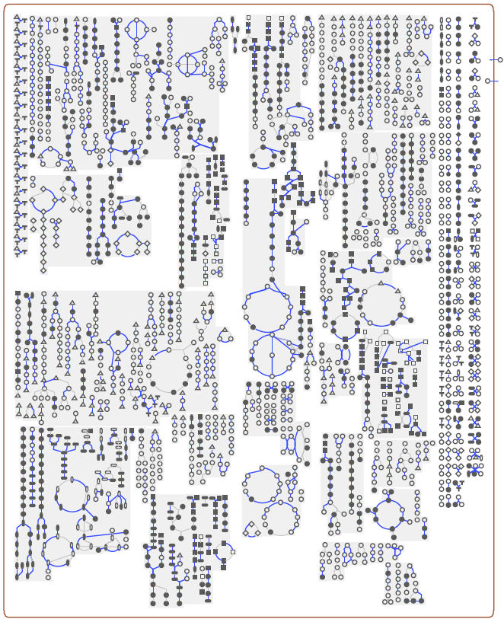
Genome-scale metabolic models
Yeast:
> 1000 reactions
Several models exist
Different purpose
Förster, Nielsen, Gen Res. 2003
Duarte, Herrgård, and Palsson, Gen Res. 2004
Küpfer, Sauer, and Blank, Gen Res. 2005
Herrgård et al., Nature Biotech. 2008

Slide 48
Summary: Stoichiometric models:
Advantages and disadvantages
advantages
disadvantages
can easily be constructed,
linear models: units (time!)
„basic“ biochemistry
cancel out
allow easy analytical access,
model complexity is limited
linear algebra
NO dynamics: steady state
large systems (genome scale)
can be considered
Based on first principles: conservation of mass and energy can be considered
=> Establishing in silico microbes
http://gcrg.ucsd.edu/downloads

Slide 49
Questions you can answer
• Derive the equation for biomass synthesis.
• What does the ATP dissipation reaction (~P = 0) account for?
• What is meant by “pseudo-steady state approximation”, when does it apply and how does it simplify the mass balance for intracellular metabolites?
Why does baker's yeast produces glycerol?

